Slide 1
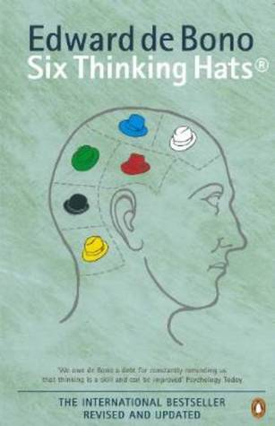
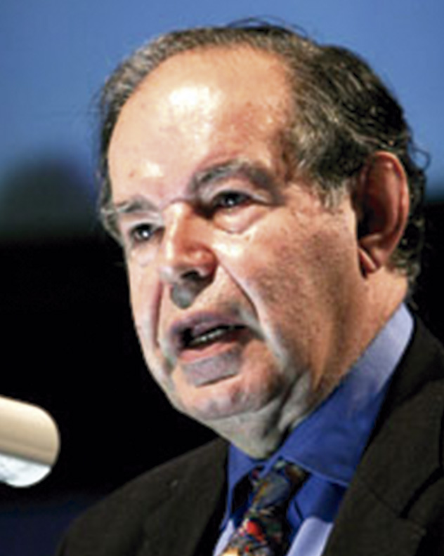
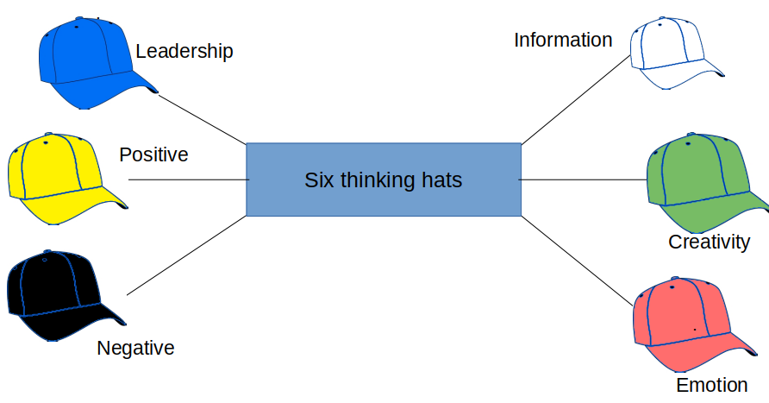
Six Thinking Hats
-by Edward de Bono
Edward de Bono is the world Known expert in Creative Thinking. The Six Thinking Hat is one such technique. The main idea is that group only “wear one hat at a time”, while considering the problem. Wearing of hat is Metaphorical. Each hat signifies its own function and speciality.

Slide 2

The Big Idea
Confusion is the Biggest Enemy of good thinking
The six thinking hats method can be used as a tool:
To create more creative atmosphere
Improve Communication
Train People to use clearer way of thinking
Hats are visual clues for us to allow an easy switch in our modes of thinking

Slide 3
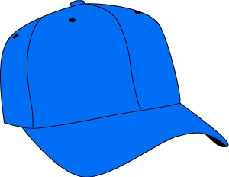
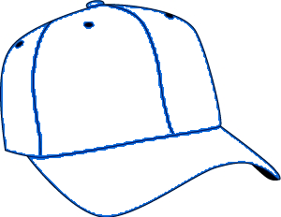
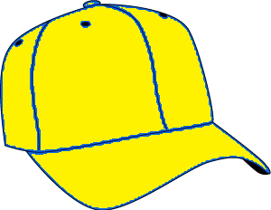
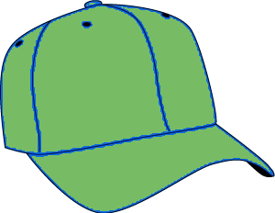

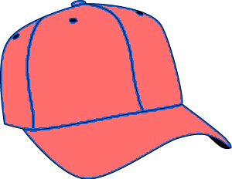
Function of Each Hat:
.
Information
Leadership
Positive
Six thinking hats
Creativity
.
Negative
Emotion

Slide 4
Definition
Actual Meaning
Briefing of
concepts
Pre-set
Application
Six Thinking Hats
Sequence
Evolving
Result
Functions of every hats
Benefits
Power
Time
Saving
Removal
Of
Ego
One
Thing
At a
Time

Slide 5
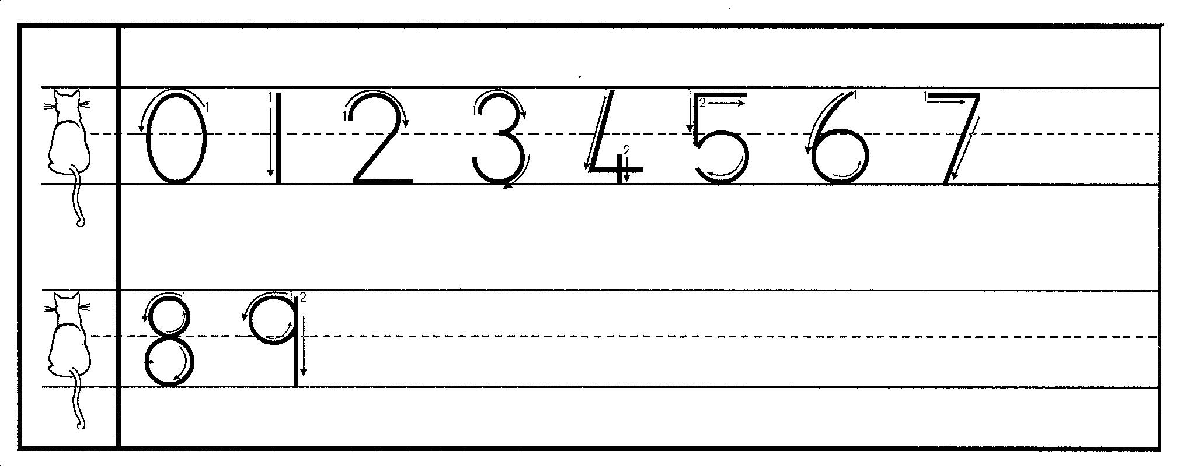
White Hat - Information
Information that we have
Information that we would like to have
Information that we Need
Information that is Missing
Source for Getting any Missing information

Slide 6

Yellow Hat - Positivity
Values And Benefits
Constructive thinking
Reason for Optimism

Slide 7

Black Hat - Negativity
Exploring Lack of Fit
Looking at the Faults
Scanning for Potential Problem
Accessing Yellow Hat output

Slide 8

Green Hat - Creativity
Expecting a Creative Effort
Adopting a Creative Attitude
Highly Recommended for Problem Solving

Slide 9

Red Hat - Emotions
.
Considering Felling in decision Making
Recognizing the Range of felling
Gut Felling Plays a Major Role

Slide 10
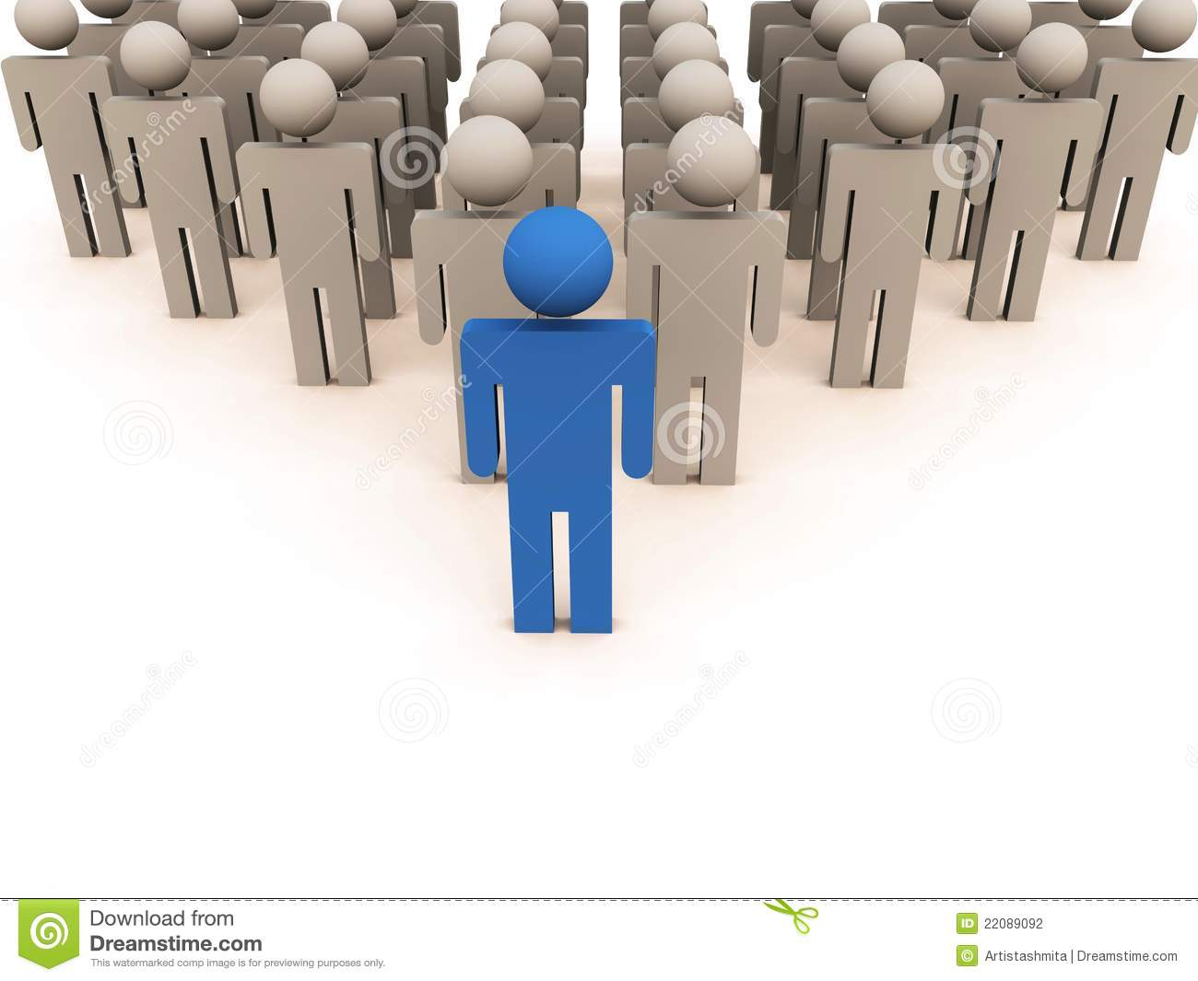
Blue Hat - Leadership
.
Defining the Focus
Setting out the Agenda
Maintaining the Discipline
Noting the Conclusion

Slide 11

Benefits
Provides a common language
Saves time
Diversity of thoughts
Stay focused. Achieve result more quickly
Develop a creative mindset
Reduces ”I am right ,you are wrong”
Problem is redefined with each perspective
Defuse Emotional and balance thinking objectively
Encourages parallel thinking
Increases productivity
Separates Ego from performance

Slide 12
How I Can Use The Hat?
Single Use
Hat may be used to request a type of thinking to direct a discussion
Sequence
Pre-Set Sequence – Setup at the beginning of the meeting under an initial blue hat.
Time is up!!
Allow one minute per person for each hat.
.
.

Slide 13
Thank You
Presented by
Yash Ganatra
Yash.ganatra@gmail.com

Slide 14
BACKUP SLIDES

Slide 15
Information
Positive
.
Creativity
Leadership
.
Negative
Emotion

